Slide 1

World Happiness Report 2021
2023-2-13 Part-Time Data Science
Khorlan Izmailova

Slide 2
THE PROBLEM
United Nations General Assembly adopted Resolution 66/281, proclaiming 20 March as International Day of Happiness.
Countries successes should be judged by the happiness of the people.
National happiness can become an operational objective for governments.

Slide 3
MEASUREMENT
The rankings of national happiness are based on a Cantril ladder survey undertaken world-wide by the polling company Gallup, Inc.
Nationally representative samples of respondents are asked to think of a ladder, with the best possible life for them being a 10, and the worst possible life being a 0. They are then asked to rate their own current lives on that 0 to 10 scale.
The report correlates the life evaluation results with various life factors.

Slide 4
DATA SOURCES
GDP: Gross Domestic Product data is sourced from the World Bank's World Development Indicators.
Social Support: This data is collected by the Gallup World Poll, which surveys people in more than 160 countries about their social support networks.
Healthy Life Expectancy: This data is also collected by the Gallup World Poll.
Freedom: The Freedom House organization provides data on political freedom and civil liberties in countries around the world.
Generosity: This data is collected by the Gallup World Poll, which asks respondents about their charitable giving and volunteering.
Absence of Corruption: This data is provided by a number of sources, including the World Bank's Worldwide Governance Indicators, Transparency International's Corruption Perceptions Index, and the Varieties of Democracy project.

Slide 5
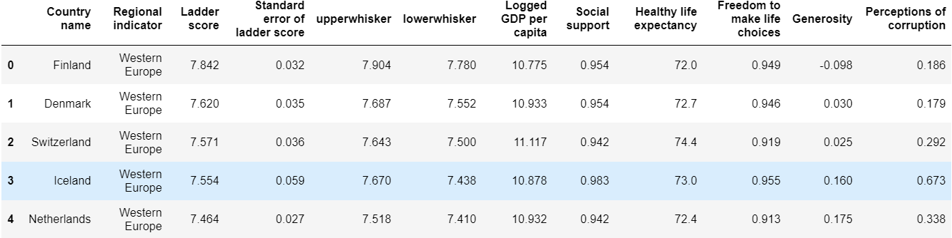
EDA
The dataset from Kaggle
It has 149 rows and 12 columns of happiness score and the score characteristics and other political, economic and health determinants of happiness score.

Slide 6
APPROACH
For happiness score EDA, I looked at
Correlations for all countries and a subset of CIS countries
Linear regression for the whole set
Logistic regression for the upper quartile of countries
Decision Tree Classifier and Regression
Random Forest Classification
Predictions for one country

Slide 7
RESULTS
Linear Regression
Accuracy: 62%
MSE:0.37(null model: 1.04)
Logistic Regression
Accuracy: 81% (null model 66%)
Confusion Matrix: ([[106, 6],
[10, 27]])
Decision Tree
Accuracy: 81%
Random Forest
Accuracy: 79% (null model 66%)
Confusion Matrix: ([[106, 6],
[9, 28]])

Slide 8
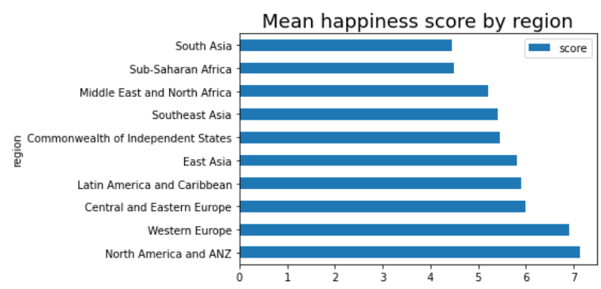
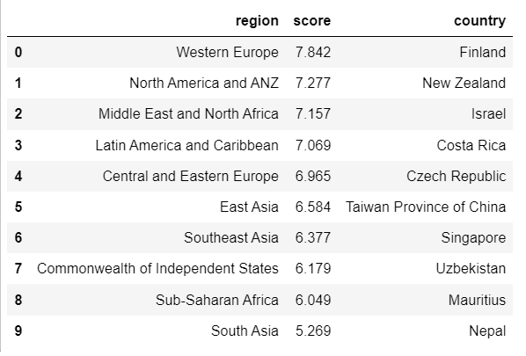
RESULTS: descriptive statistics
Maximum happiness score by region

Slide 9
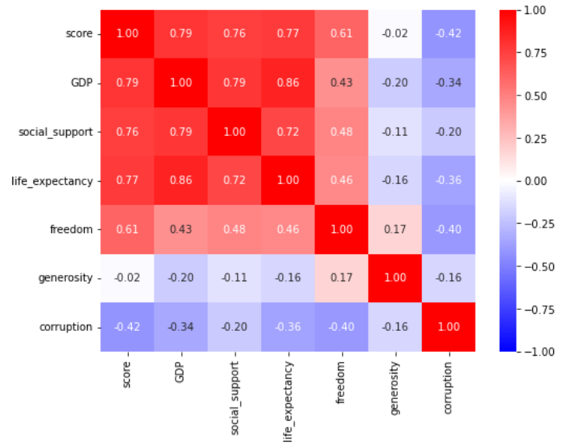
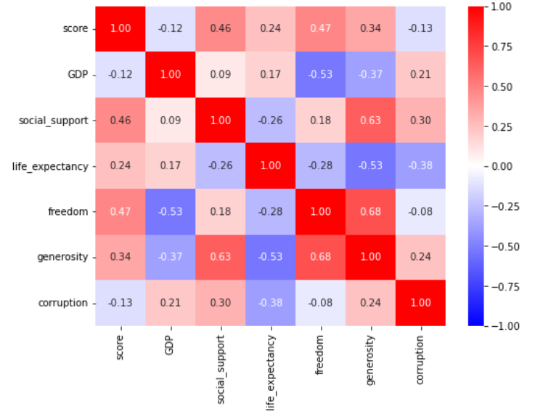
CORRELATIONS
All countries
CIS countries
Strong correlations with almost all features
Weaker correlations, GDP becomes negative

Slide 10
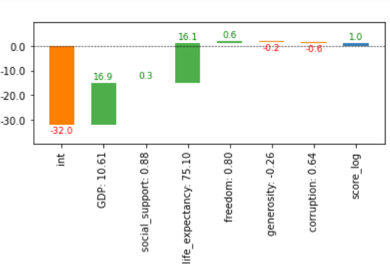
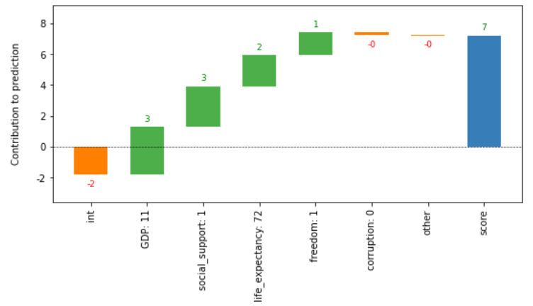
RESULTS
Linear regression
Logistic regression
GDP, social support, health life expectancy and freedom to make choice are important determinants of happiness.
Social support, and freedom to make life choices lose their importance for becoming the 25% happiest countries.

Slide 11
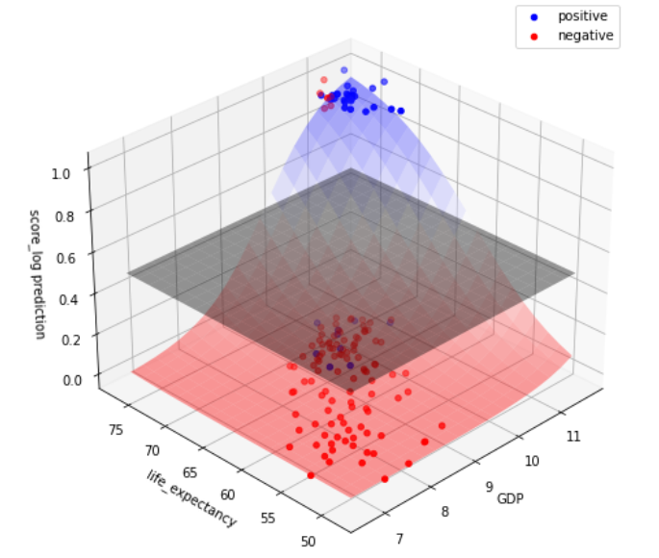
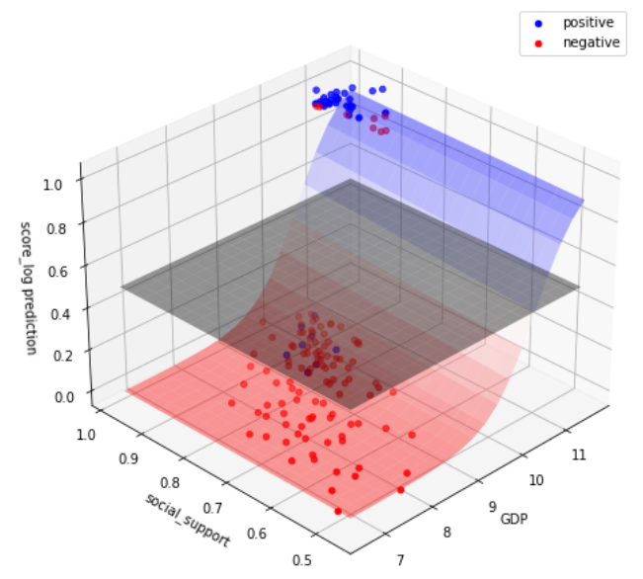
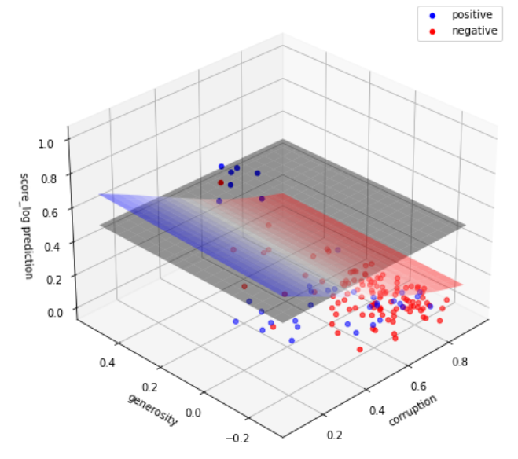
GDP and social support- GDP is strong
CLASSIFICATION
GDP and healthy life expectancy-
Both strong features
Corruption and generosity-
Corruption is stronger but both are weak features

Slide 12
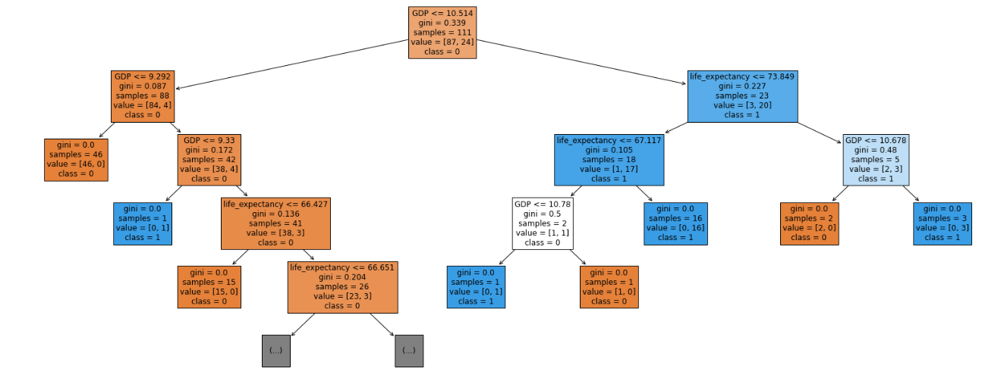
Decision Tree Classifier (score_log)

Slide 13
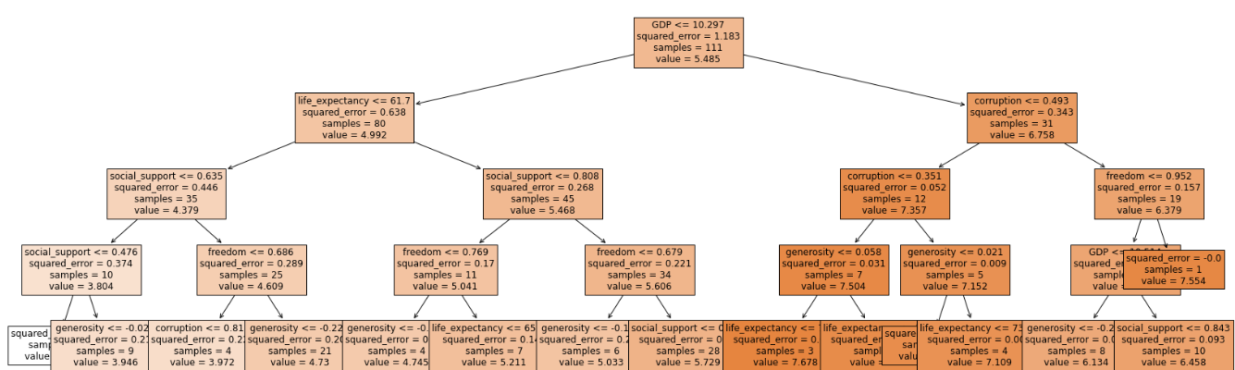
Decision Tree Regressor (score)

Slide 14
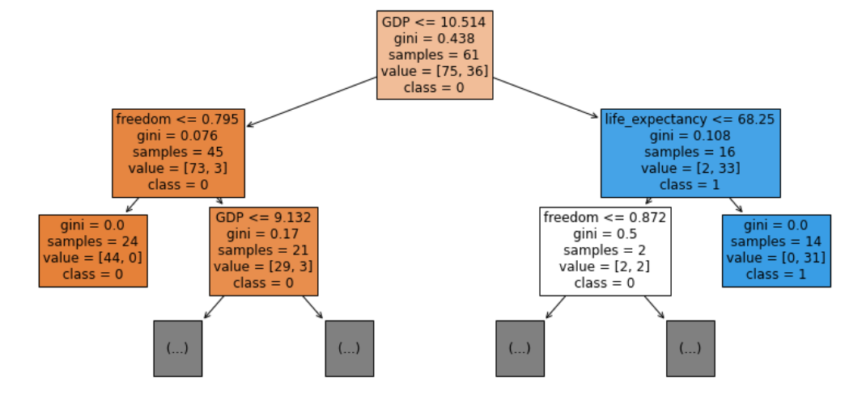
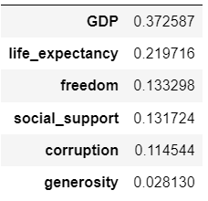
Random Forest Classifier
feature_importances

Slide 15
Summary, next steps
More improvements of the RFC model.
Look at the logistic regression and try more improvements of the model.

